Slide 1
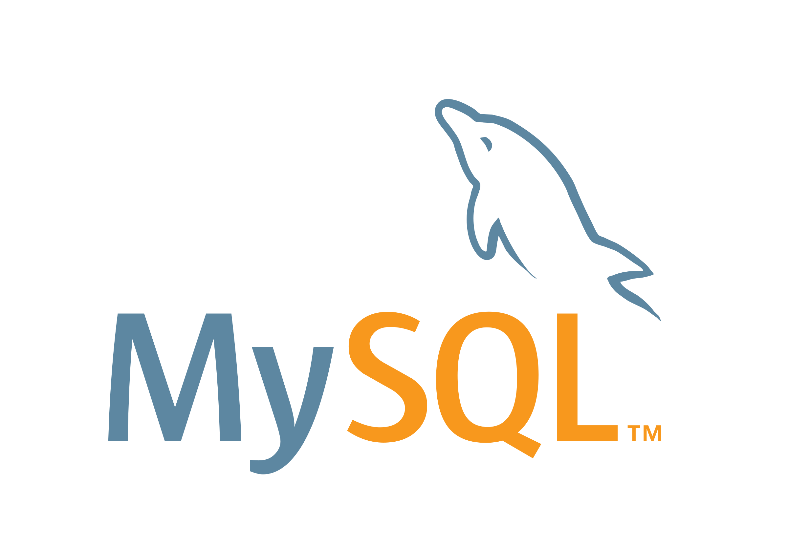
SQL Scripting Introduction

Slide 2
Introduction to Databases
Introduction to SQL/NoSQL
Advantages and Disadvantages

Slide 3
Introduction to SQL
SQL is a standard language for accessing and manipulating databases.
SQL stands for Structured Query Language
SQL lets you access and manipulate databases
SQL became a standard of the American National Standards Institute (ANSI) in 1986, and of the International Organization for Standardization (ISO) in 1987

Slide 4
SQL can execute queries against a database
SQL can retrieve data from a database
SQL can insert records in a database
SQL can update records in a database
SQL can delete records from a database
SQL can create new databases
SQL can create new tables in a database
SQL can create stored procedures in a database
SQL can create views in a database
SQL can set permissions on tables, procedures, and views

Slide 5
Using SQL in Your Web Site
To build a web site that shows data from a database, you will need:
An RDBMS database program (i.e. MS Access, SQL Server, MySQL)
To use a server-side scripting language, like PHP or ASP
To use SQL to get the data you want
To use HTML / CSS to style the page

Slide 6
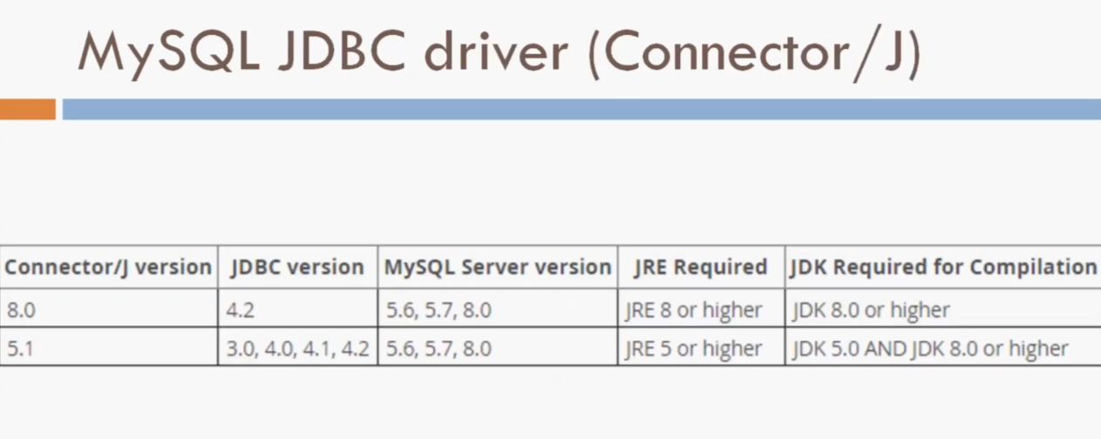

Slide 7
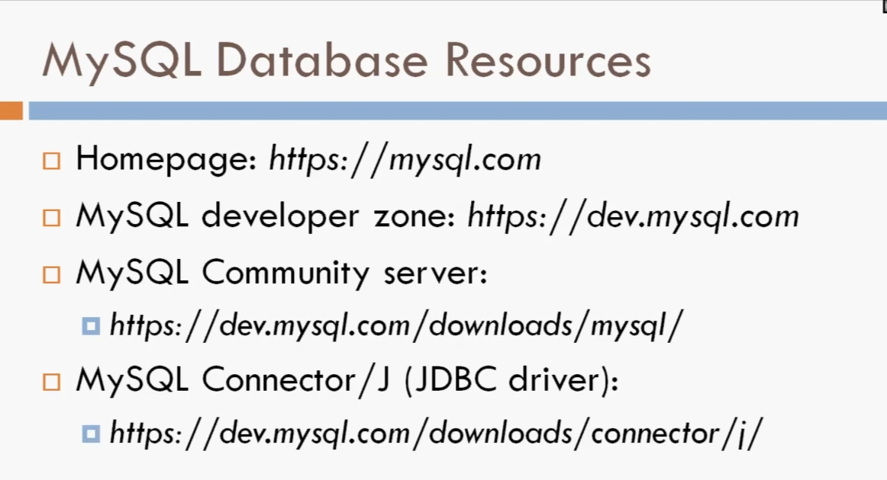

Slide 8
Rules
Structure query language is not case sensitive. Generally, keywords of SQL are written in uppercase.
Statements of SQL are dependent on text lines. We can use a single SQL statement on one or multiple text line.
Using the SQL statements, you can perform most of the actions in a database.
SQL depends on tuple relational calculus and relational algebra.

Slide 9
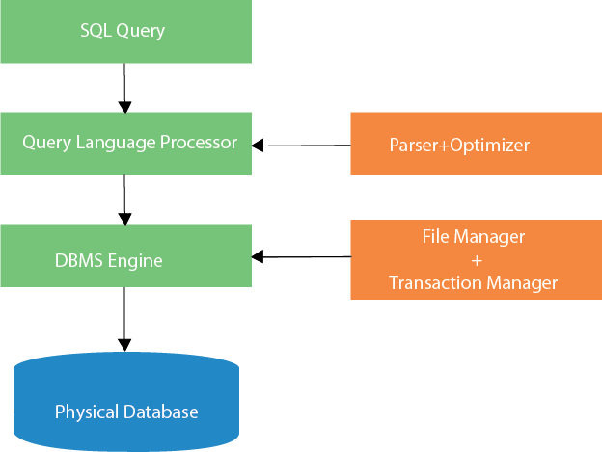
SQL process

Slide 10
RDBMS
RDBMS stands for Relational Database Management System.
RDBMS is the basis for SQL, and for all modern database systems such as MS SQL Server, IBM DB2, Oracle, MySQL, and Microsoft Access.
The data in RDBMS is stored in database objects called tables. A table is a collection of related data entries and it consists of columns and rows.

Slide 11
SQL Command
SQL defines following ways to manipulate data stored in an RDBMS.
DDL: Data Definition Language
DML: Data Manipulation Language
TCL: Transaction Control Language
DCL: Data Control Language
DQL: Data Query Language

Slide 12
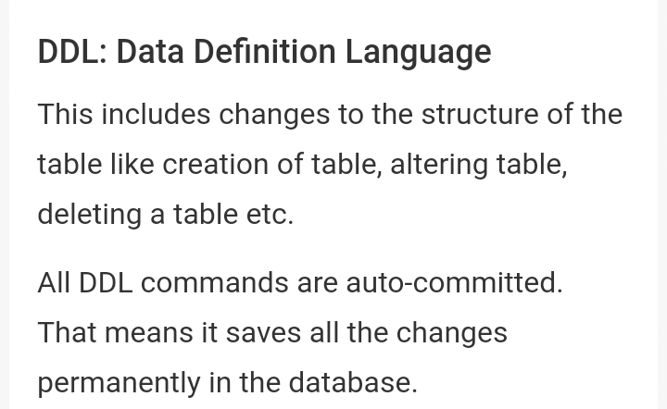

Slide 13
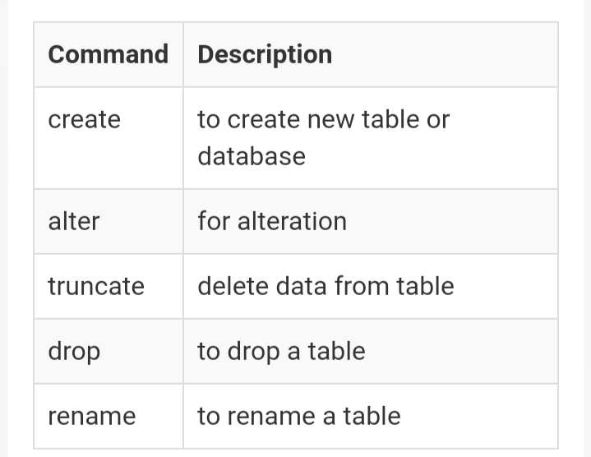

Slide 14
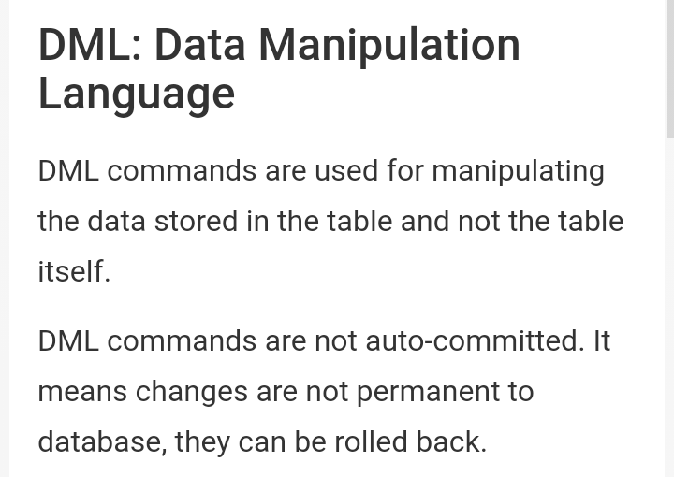

Slide 15
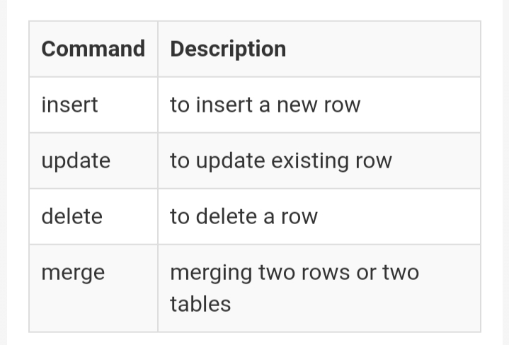

Slide 16
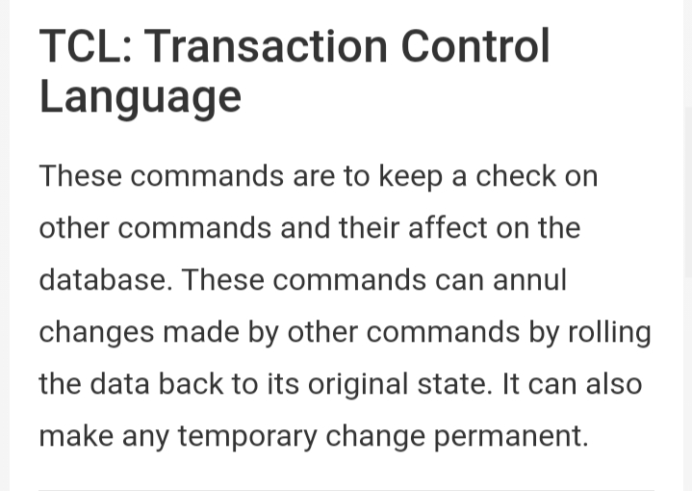

Slide 17
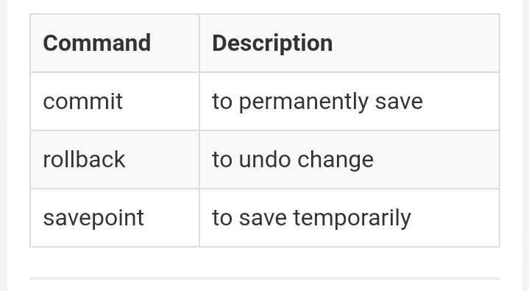

Slide 18
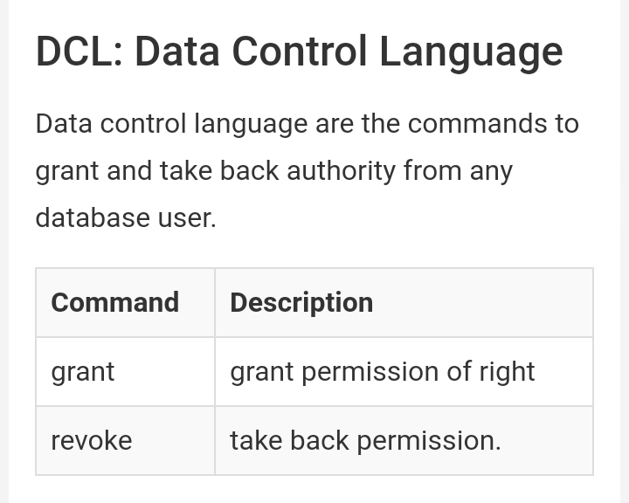

Slide 19
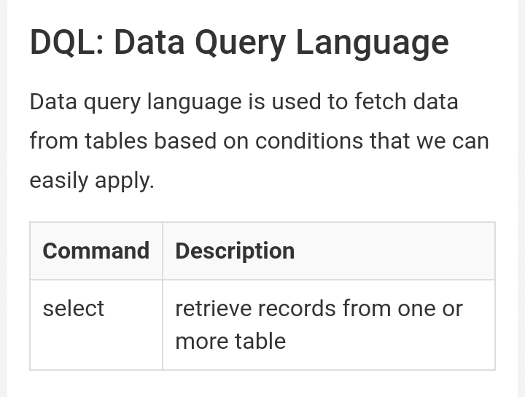

Slide 20
Introduction to NoSQL
A NoSQL originally referring to non SQL or non relational is a database that provides a mechanism for storage and retrieval of data.
This data is modeled in means other than the tabular relations used in relational databases.
NoSQL databases are used in real-time web applications and big data and their use are increasing over time.

Slide 21
NoSQL systems are also sometimes called Not only SQL to emphasize the fact that they may support SQL-like query languages.
NoSQL database includes simplicity of design, simpler horizontal scaling to clusters of machines and finer control over availability.
Free and popular NoSQL databases
MongoDB
Redis
Couch DB
RavenDB

Slide 22
Advantages of SQL
It is a user-friendly and domain-specific language.
It is widely used in the Business Intelligence tool.
Data Science tools depend highly on SQL.
Big data tools such as Spark, Impala are dependant on SQL.
. It is a reliable and efficient language used for communicating with the database.

Slide 23
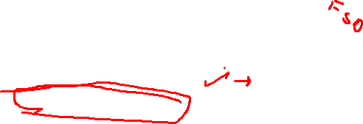
Faster Query Processing
No Coding Skills
Standardised Language
Portable
Interactive Language
Multiple data views

Slide 24
Disadvantages
Complex Interface
Cost
Partial Control

Slide 25


